Slide 1

Welcome to join Harbor Community Conference Call
05:00-05:30 AM (PDT) /
21:00-21:30 (Beijing Time)
2019/12/04 Wednesday
https://zoom.us/j/734959521
Twitter
Maillist
Slack (slack.cncf.io)
@project_harbor
harbor-users@lists.cncf.io
#harbor
#harbor-dev
harbor-dev@lists.cncf.io

Slide 2

Release V1.8 – Prepare script refactor
Meeting Host
Steven Zou (github:steven-zou)
Harbor core maintainer

Slide 3
Agenda
Community updates
KubeCon SanDiego 2019 updates
Upcoming Events
Other updates
Release updates
Major release 1.10 updates
Patch release 1.8.6 and 1.9.3
Release v1.11 plan
Involvement in the upstream projects of Harbor

Slide 4
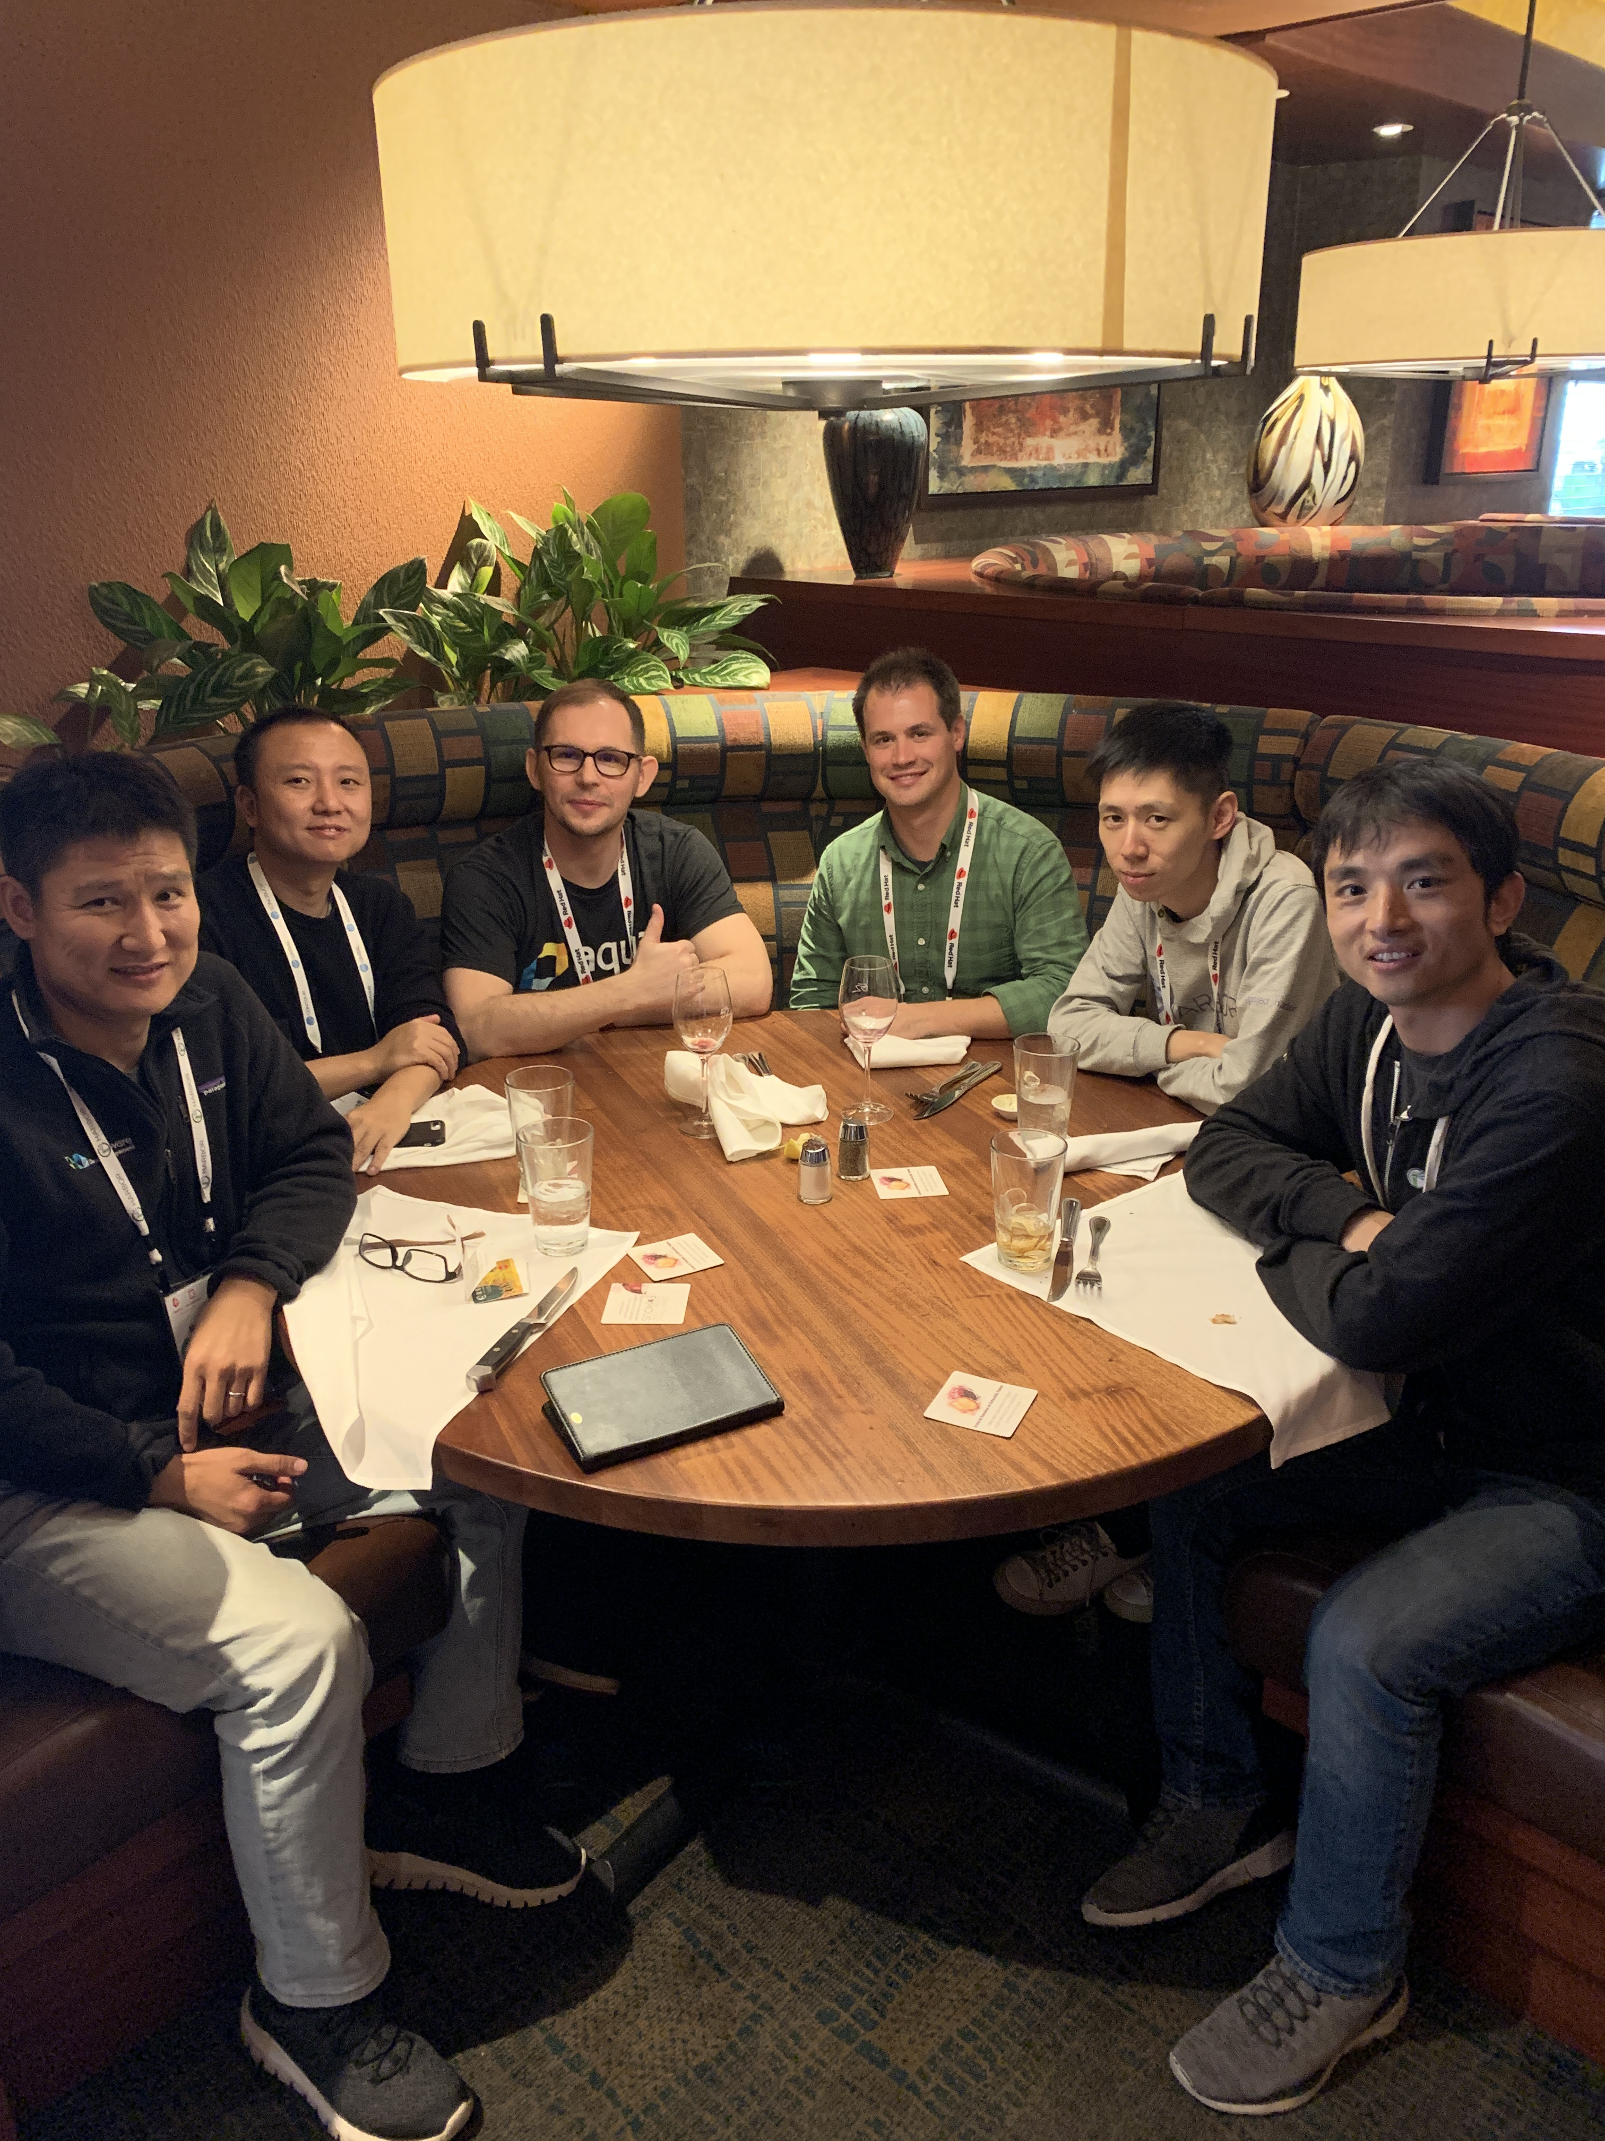
Community –KubeCon San Diego 2019
2019/11/18 : Harbor lunch and learn workshop
Lead by Alex Xu
About 50 attendees
Learn Harbor from deployment and try some key use cases
2019/11/19: Harbor Introduction
By Alex Xu & Steven Ren
First time using live demo of Harbor – Very successful!
Marked by near 400 peoples and about 100 attendees
2019/11/20: Harbor Deep Dive
By Steven Zou & Daniel Jiang with two guest speakers (Michael M and Daniel P from Aqua)
Share the pluggable scanner and insights of Harbor
Marked by near 400 peoples and about 100 attendees
Talk to / have discussions with users
Meeting other Harbor maintainers/contributors F2F
Slides download link: https://events19.linuxfoundation.org/events/kubecon-cloudnativecon-north-america-2019/schedule/

Slide 5
Community – Upcoming events
Dec. 11th Wednesday 10AM (Beijing Time zone): CNCF Webinar
Topic: Gain Confidence in Compliance: Advanced Image Scanning with Harbor
By Steven Zou
Live Demo included
Dec. 14^{th,} Saturday : Harbor meetup at ShenZhen China
By Harbor Community, VMware VIN and Tencent
For details, please pay attentions to the WeChat channels
Steven Ren & Steven Zou will be there to communicate with Harbor users/contributors F2F

Slide 6
Community - Misc
Harbor GitHub stars - 10K+ !
Very important milestone
Graduated from CNCF is still under review and overall feedbacks are positive so far.
P2P WG is setup to work on the integration between Harbor and P2P providers (Dragonfly, Uber Kraken) in the 1.11 timeline
Kick off on Thursday
Involve
Ali Dragonfly team
Uber Kraken maintainers
Harbor maintainers (Steven Z, Frank, Ming and De Chen)
Active contributors (ChenYu Zhang)
PM: Alex Xu

Slide 7
Release 1.10
RC2: This Friday
GA: Next week
Bug fixes: https://github.com/goharbor/harbor/issues?q=is%3Aissue+is%3Aopen+label%3Atarget%2F1.10.0

Slide 8
Patch Releases
Patch releases
1.8.6
1.9.3
Fix security issues:
https://github.com/goharbor/harbor/security/advisories/GHSA-qcfv-8v29-469w
https://github.com/goharbor/harbor/security/advisories/GHSA-rh89-vvrg-fg64
https://github.com/goharbor/harbor/security/advisories/GHSA-3868-7c5x-4827
https://github.com/goharbor/harbor/security/advisories/GHSA-6qj9-33j4-rvhg
https://github.com/goharbor/harbor/security/advisories/GHSA-gcqm-v682-ccw6

Slide 9












Release v1.11 plan
1
Management
K8s
Operator
Signing Policy
Replication
Metadata
Management
Observability
Perf & Scale
2
Image
Distribution
P2P
Distribution
Proxy Cache
3
Extensibility
Cloud Native
Artifact Management
Webhook++
Interrogation
Service++

Slide 10
Involvement in the upstream projects of Harbor
Distribution (https://github.com/docker/distribution)
Help release new versions
Help fixing bugs
https://github.com/docker/distribution/issues/2094
https://github.com/docker/distribution/issues/3004
….
Notary
Justin Cormack kicks off notary V2 in Kubcon San Diego.
Make the signature replicable.
Provide more friendly API.

Slide 11
Topics?
Any topics to discuss here?

Slide 12
Meeting minutes
Meeting is recorded and the recording link will be updated to the meeting schedule doc later: https://github.com/goharbor/community/blob/master/MEETING_SCHEDULE.md
The meeting slides will be uploaded to the community repo https://github.com/goharbor/community and put under the ‘conf-calls’ folder.

